Slide 1
Image features from Phase Congruency
Presented by Sequoia andrade
Paper by Peter Kovesi

Slide 2
Outline
Edge detection
Review of Fourier Series
Local Energy and Phase Congruency
Calculating phase congruency via wavelets
Noise
The importance of frequency spread
Extension to 2-D
2-D filter design, Filter orientations, Combining Data
Scale via high-pass filtering
Experimental results
Conclusion
Kovesi’s Paper
[1, 2]

Slide 3
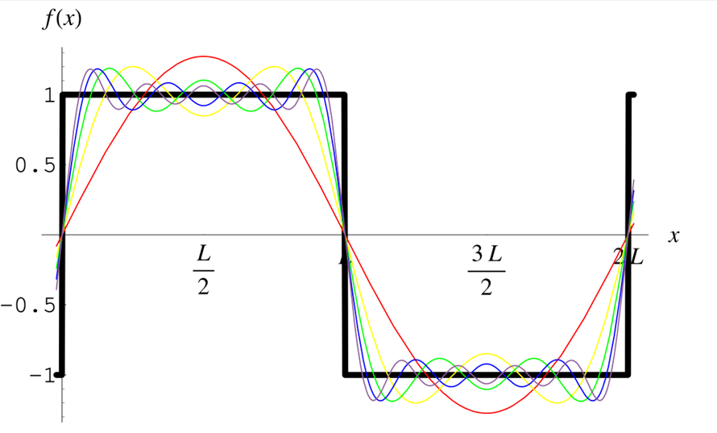
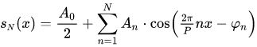
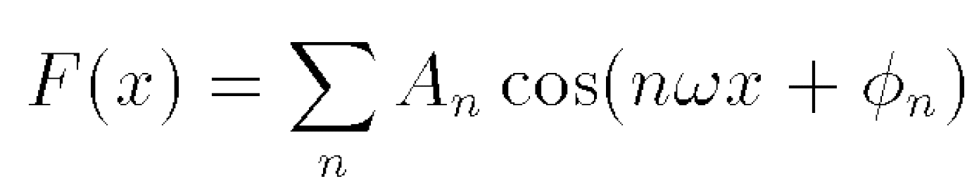
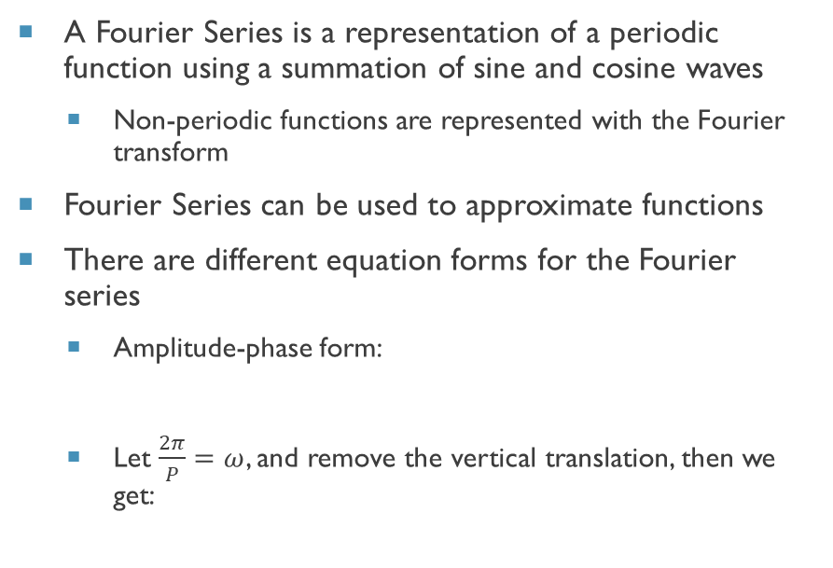
Fourier Series
A Fourier Series is a representation of a periodic function using a summation of sine and cosine waves
Non-periodic functions are represented with the Fourier transform
Fourier Series can be used to approximate functions
There are different equation forms for the Fourier series
Amplitude-phase form:
Let $\frac{2π}{P}=ω$, and remove the vertical translation, then we get:
[3]

Slide 4
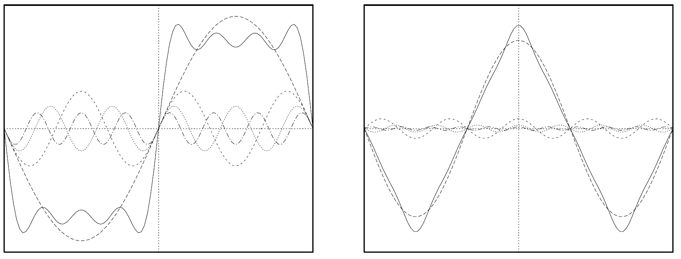
Phase Congruency

Slide 5
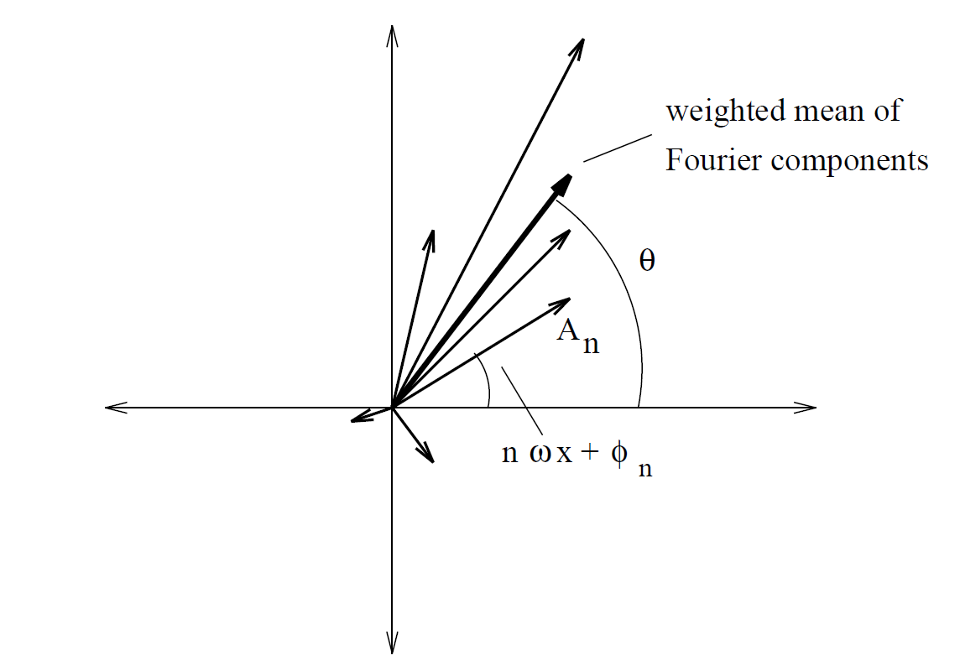
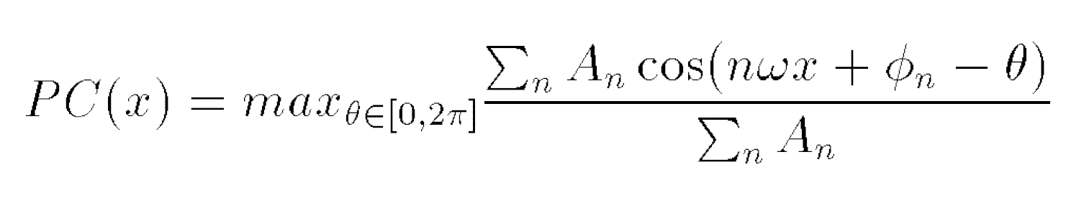
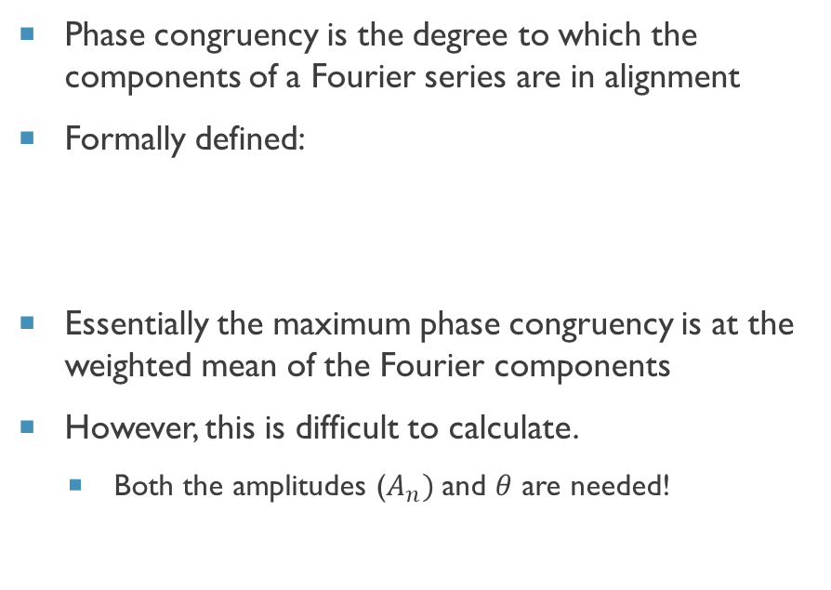
Local Energy and Phase congruency
Phase congruency is the degree to which the components of a Fourier series are in alignment
Formally defined:
Essentially the maximum phase congruency is at the weighted mean of the Fourier components
However, this is difficult to calculate.
Both the amplitudes ($A_{n})$and $θ$ are needed!

Slide 6
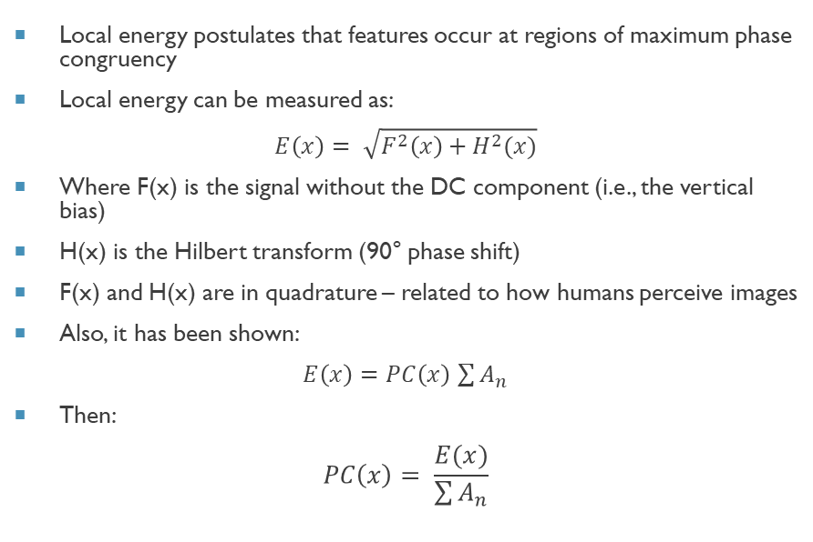
Local Energy and Phase congruency
Local energy postulates that features occur at regions of maximum phase congruency
Local energy can be measured as:
$$E\left(x\right)= \sqrt{F^{2}\left(x\right)+H^{2}(x)}$$
Where F(x) is the signal without the DC component (i.e., the vertical bias)
H(x) is the Hilbert transform (90° phase shift)
F(x) and H(x) are in quadrature – related to how humans perceive images
Also, it has been shown:
$E\left(x\right)=$ $PC\left(x\right)$ $\sum{A_{n}}$
Then:
$$PC\left(x\right)= \frac{E(x)}{\sum{A_{n}}}$$
Notes:
DC component is removed bc Hilbert transform does not impact it
Issue with units – normalize local energy by the amplitudes to get rid of units
Issue with local energy this way – need to look at windows/regions
Issue with spread of the frequency

Slide 7
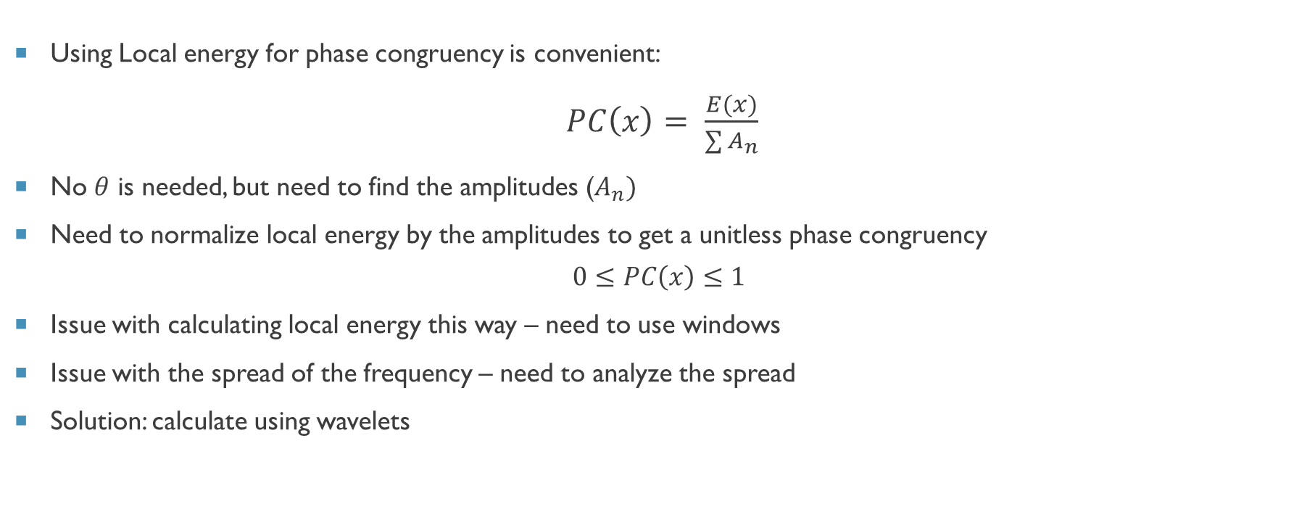
Local Energy and Phase congruency
Using Local energy for phase congruency is convenient:
$PC\left(x\right)= \frac{E(x)}{\sum{A_{n}}}$
No $θ$ is needed, but need to find the amplitudes ($A_{n})$
Need to normalize local energy by the amplitudes to get a unitless phase congruency
$$0≤PC\left(x\right)≤1$$
Issue with calculating local energy this way – need to use windows
Issue with the spread of the frequency – need to analyze the spread
Solution: calculate using wavelets
Notes:
DC component is removed bc Hilbert transform does not impact it
Issue with units – normalize local energy by the amplitudes to get rid of units
Issue with local energy this way – need to look at windows/regions
Issue with spread of the frequency

Slide 8
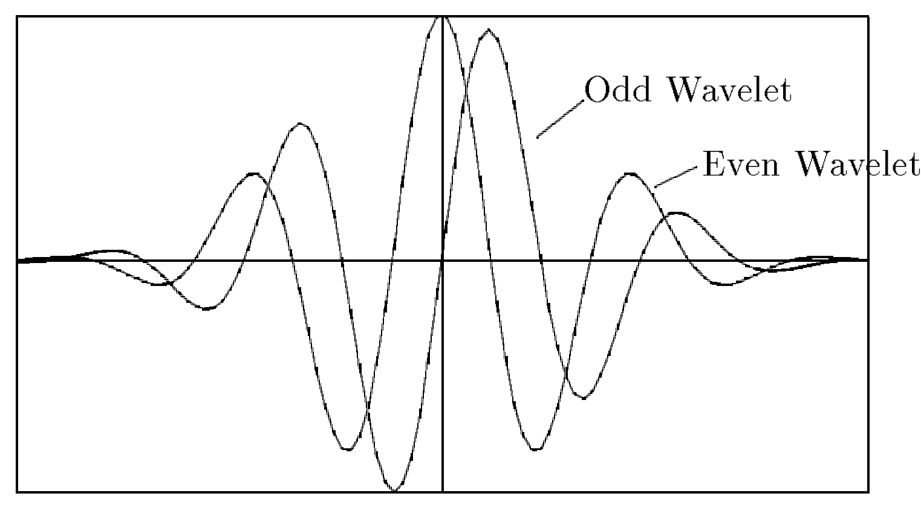
Calculating phase congruency via wavelets
Wavelet transforms are used for local frequency analysis using a bank of wavelets
Wavelets in the bank are scaled (logarithmically), thus each wavelet detects specific frequencies
This paper uses log Gabor waves (right), which are sine and cosine waves modulated by a Gaussian
Gabor waves are in quadrature – similar to local energy calculation
This allows for the calculation of both amplitude and phase

Slide 9
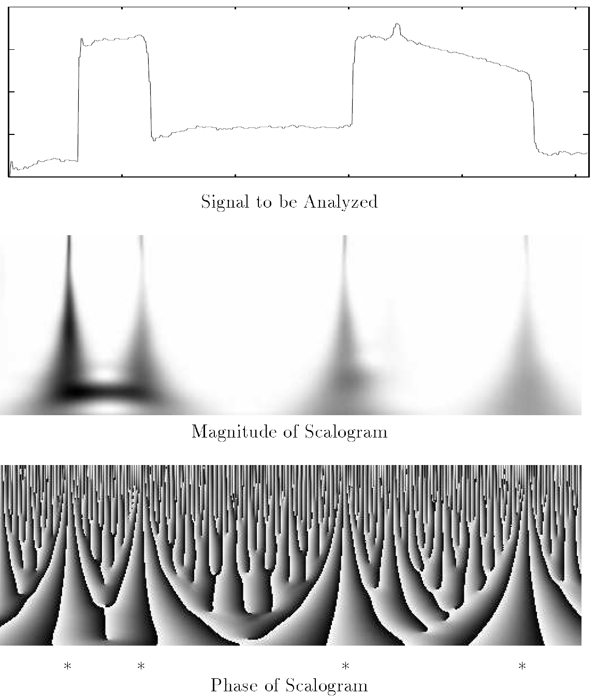
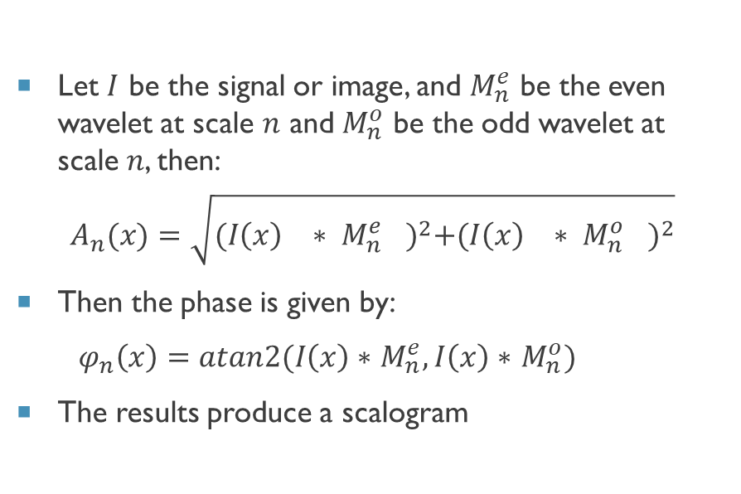
Calculating phase congruency via wavelets
Let $I$ be the signal or image, and $M_{n}^{e}$ be the even wavelet at scale $n$ and $M_{n}^{o}$ be the odd wavelet at scale $n$, then:
$$A_{n}(x)=\sqrt{{({I\left(x\right)}^{}∗ {M_{n}^{e}}^{})}^{2}+{({I\left(x\right)}^{}∗ {M_{n}^{o}}^{})}^{2}}$$
Then the phase is given by:
$φ_{n}\left(x\right)=atan2(I\left(x\right)∗$ $M_{n}^{e}, I\left(x\right)∗$ $M_{n}^{o})$
The results produce a scalogram

Slide 10
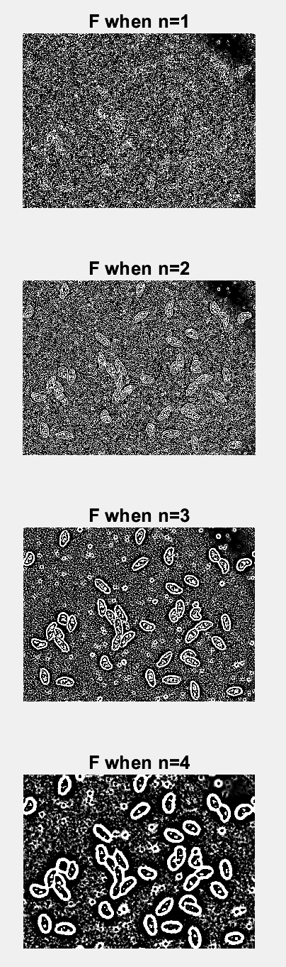
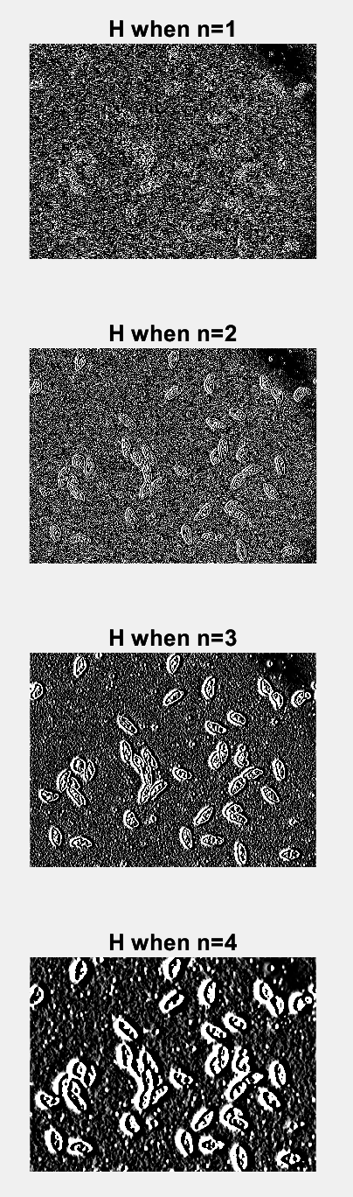
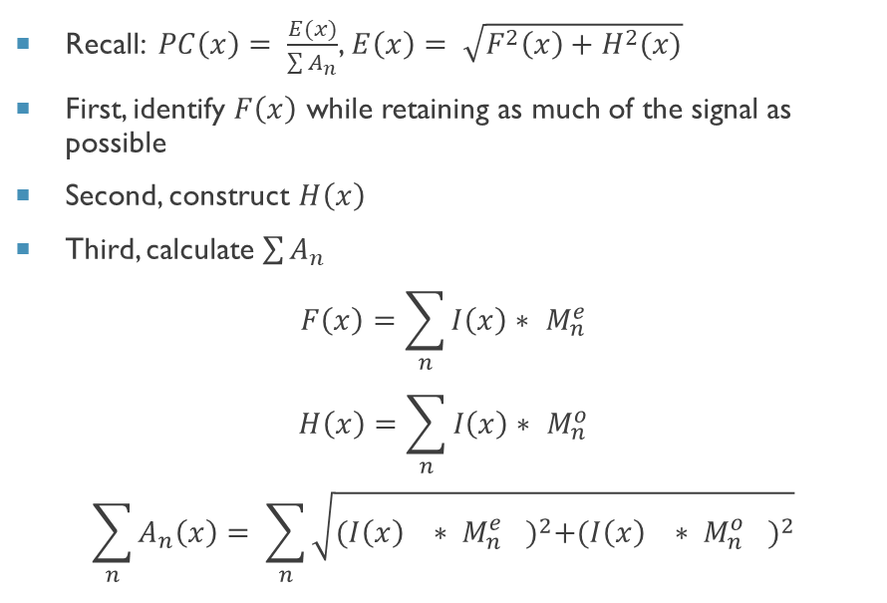
Calculating phase congruency via wavelets
Recall: $PC\left(x\right)= \frac{E(x)}{\sum{A_{n}}}$, $E\left(x\right)= \sqrt{F^{2}\left(x\right)+H^{2}(x)}$
First, identify $F\left(x\right)$ while retaining as much of the signal as possible
Second, construct $H\left(x\right)$
Third, calculate $\sum{A_{n}}$
$$F\left(x\right)=\sum_{n}{I\left(x\right)∗ M_{n}^{e}}$$
$$H\left(x\right)=\sum_{n}{I\left(x\right)∗ M_{n}^{o}}$$
$$\sum_{n}{A_{n}\left(x\right)= \sum_{n}{\sqrt{{({I\left(x\right)}^{}∗ {M_{n}^{e}}^{})}^{2}+{({I\left(x\right)}^{}∗ {M_{n}^{o}}^{})}^{2}}}}$$

Slide 11
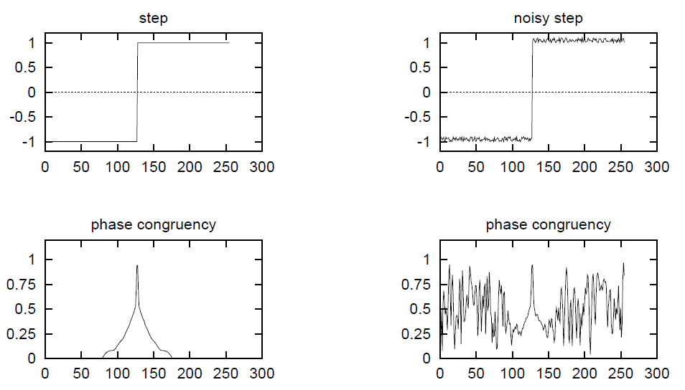
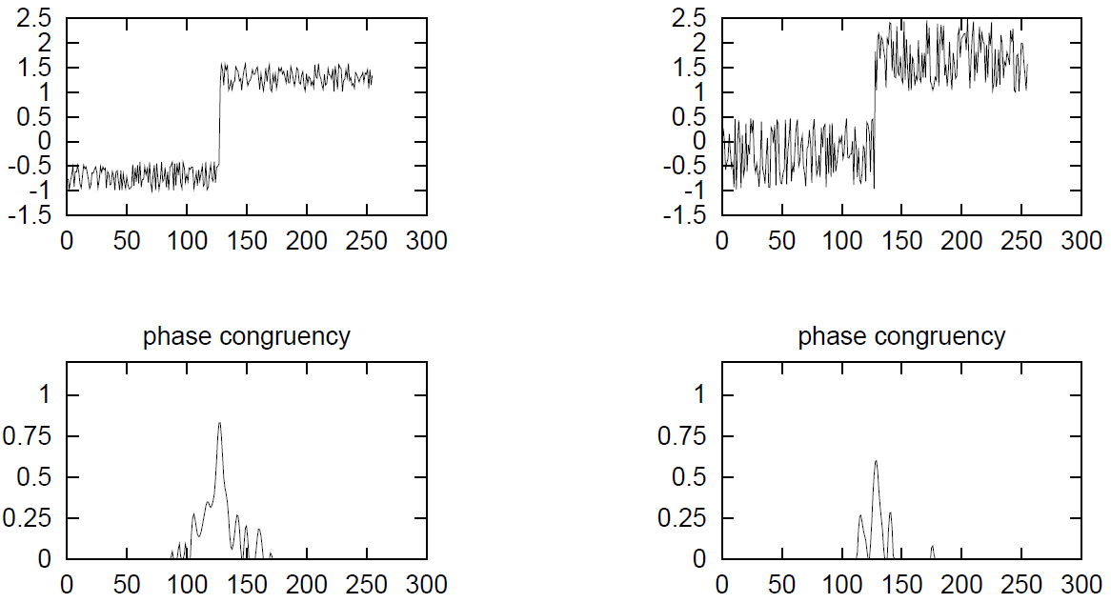
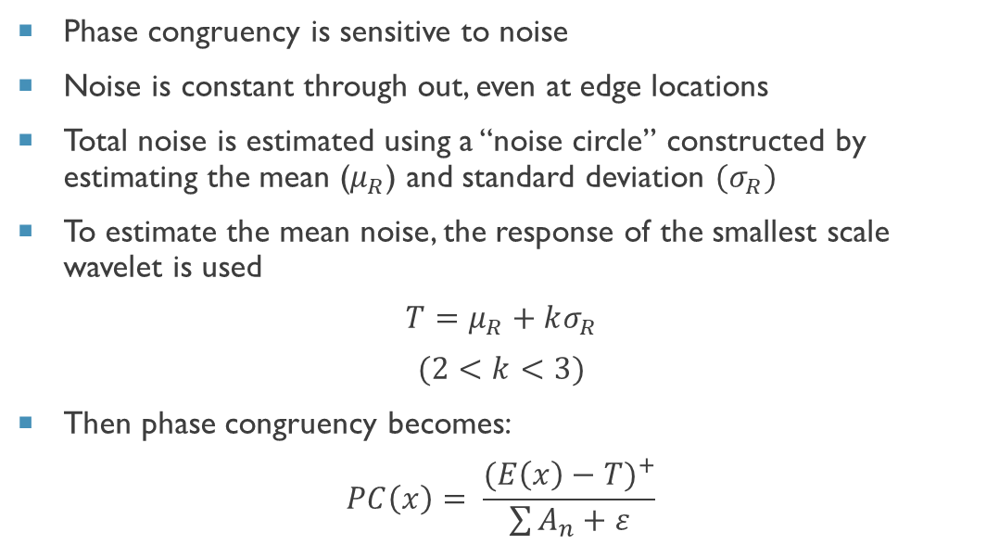
Noise
Without noise estimates
Phase congruency is sensitive to noise
Noise is constant through out, even at edge locations
Total noise is estimated using a “noise circle” constructed by estimating the mean ($μ_{R}$) and standard deviation ${(σ}_{R})$
To estimate the mean noise, the response of the smallest scale wavelet is used
$$T=μ_{R}+kσ_{R}$$
$$(2<k<3)$$
Then phase congruency becomes:
$$PC\left(x\right)= \frac{{(E\left(x\right)−T)}^{+}}{\sum{A_{n}}+ε}$$
With noise estimates

Slide 12
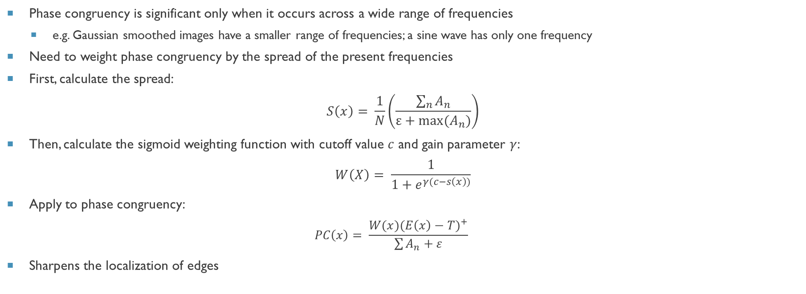
The importance of frequency spread
Phase congruency is significant only when it occurs across a wide range of frequencies
e.g. Gaussian smoothed images have a smaller range of frequencies; a sine wave has only one frequency
Need to weight phase congruency by the spread of the present frequencies
First, calculate the spread:
$$S\left(x\right)= \frac{1}{N}\left(\frac{\sum_{n}{A_{n}}}{ε+max⁡(A_{n})}\right)$$
Then, calculate the sigmoid weighting function with cutoff value $c$ and gain parameter $γ$:
$$W\left(X\right)= \frac{1}{1+e^{γ(c−s\left(x\right))}}$$
Apply to phase congruency:
$$PC\left(x\right)= \frac{{W(x)(E\left(x\right)−T)}^{+}}{\sum{A_{n}}+ε}$$
Sharpens the localization of edges

Slide 13
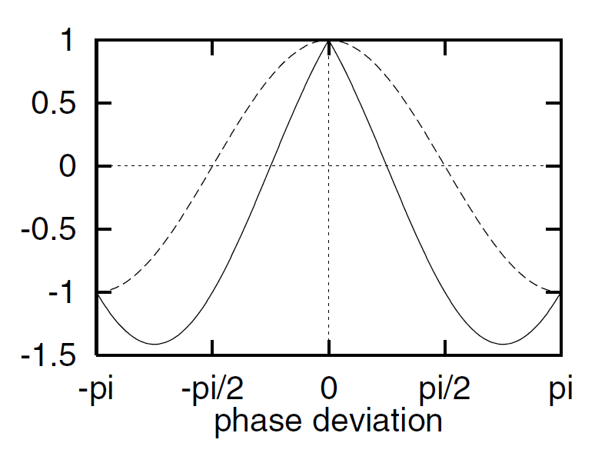
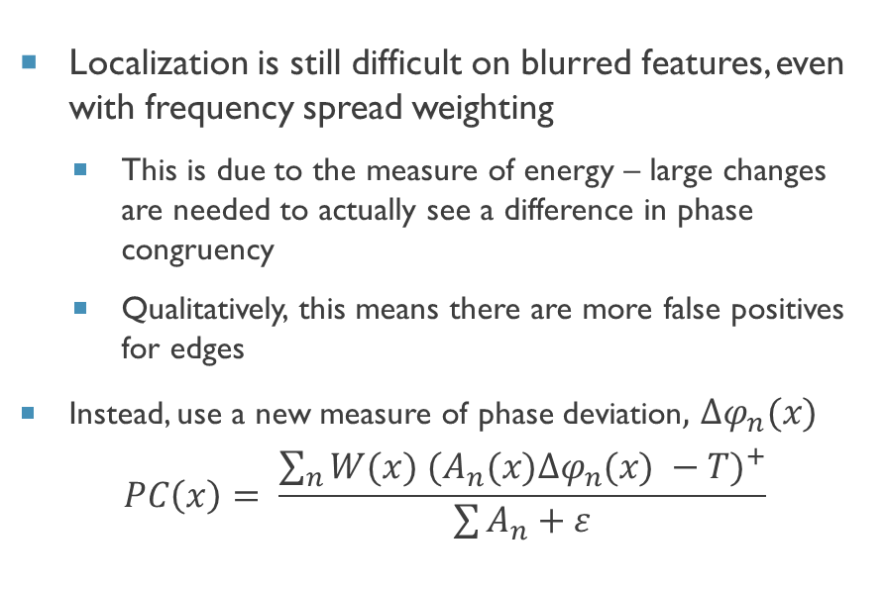
A New measure of phase congruency
Localization is still difficult on blurred features, even with frequency spread weighting
This is due to the measure of energy – large changes are needed to actually see a difference in phase congruency
Qualitatively, this means there are more false positives for edges
Instead, use a new measure of phase deviation, ${∆φ}_{n}(x)$
$$PC\left(x\right)= \frac{\sum_{n}{{W(x) (A_{n}(x){∆φ}_{n}(x) −T)}^{+}}}{\sum{A_{n}}+ε}$$

Slide 14
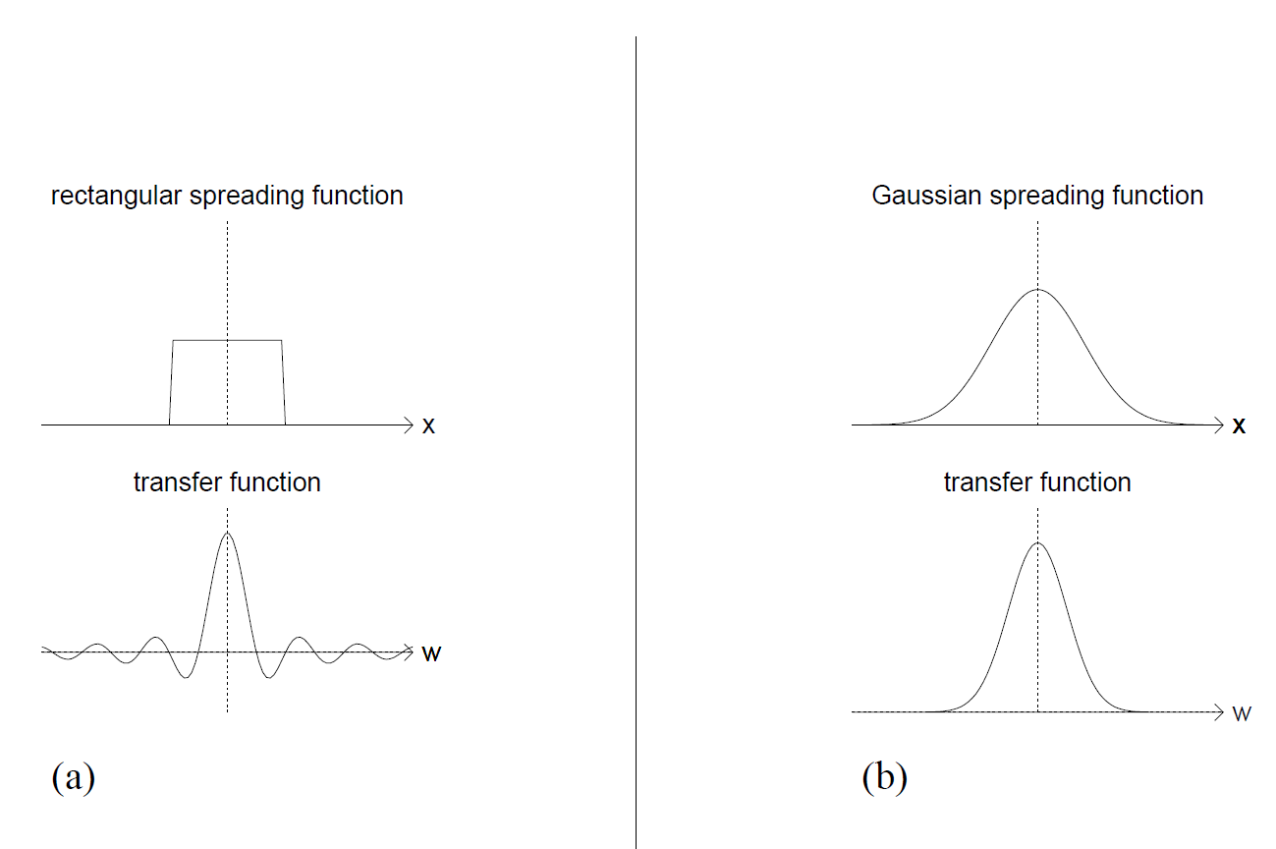
2-d filter design
The 1-D filters can be extended to 2-D by applying a spreading function in the direction perpendicular to the filter
A gaussian spreading function is preferred because it preserves information
For example, the rectangular spreading function makes some values negative in contrast to the gaussian

Slide 15
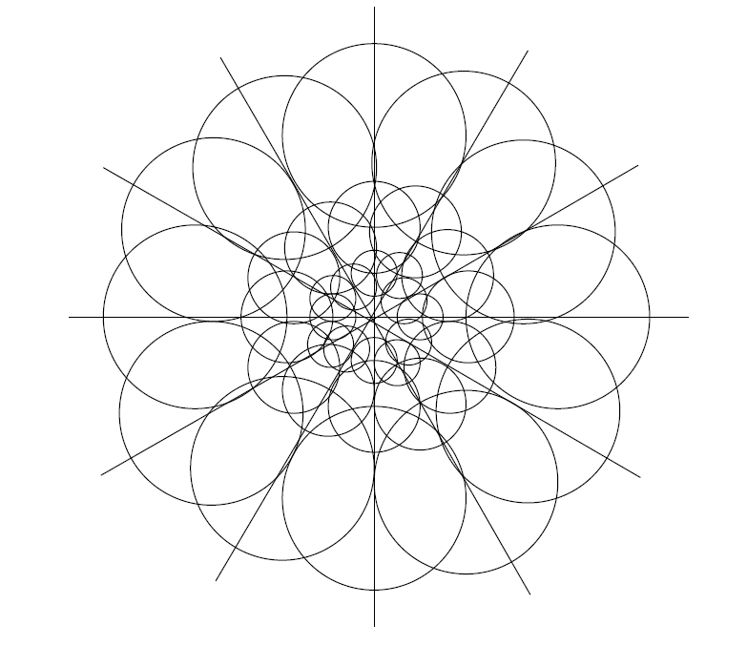
Filter orientations
Problem: in 2-D there are many orientations of features
Solution: Filters must tile the frequency plane uniformly to get all orientations
The length to width ratio controls the filter sensitivity
The ideal tiling is the rosette at the right, shown with different scale filters
Length to width ration of 1 and 30º separation

Slide 16
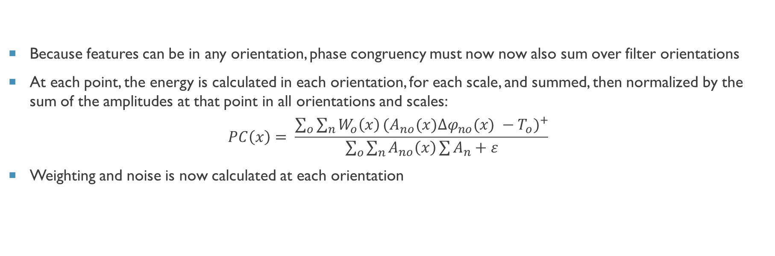
Combining data over several orientations
Because features can be in any orientation, phase congruency must now now also sum over filter orientations
At each point, the energy is calculated in each orientation, for each scale, and summed, then normalized by the sum of the amplitudes at that point in all orientations and scales:
$$PC\left(x\right)= \frac{{\sum_{o}{\sum_{n}{W_{o}\left(x\right)}}(A_{no}(x){∆φ}_{no}(x) −T_{o})}^{+}}{\sum_{o}{\sum_{n}{A_{no}\left(x\right)}}\sum{A_{n}}+ε}$$
Weighting and noise is now calculated at each orientation

Slide 17
Scale via high pass filtering
Traditional approaches use low-pass or band-pass filtering which identify the high-level or broad features
The location and number of features in an image depends on the scale
Instead, phase congruency utilizes high-pass filtering to specify the scale (window size of the filter)
Small windows look at local features
Larger windows look at more global features
Improves localization

Slide 18
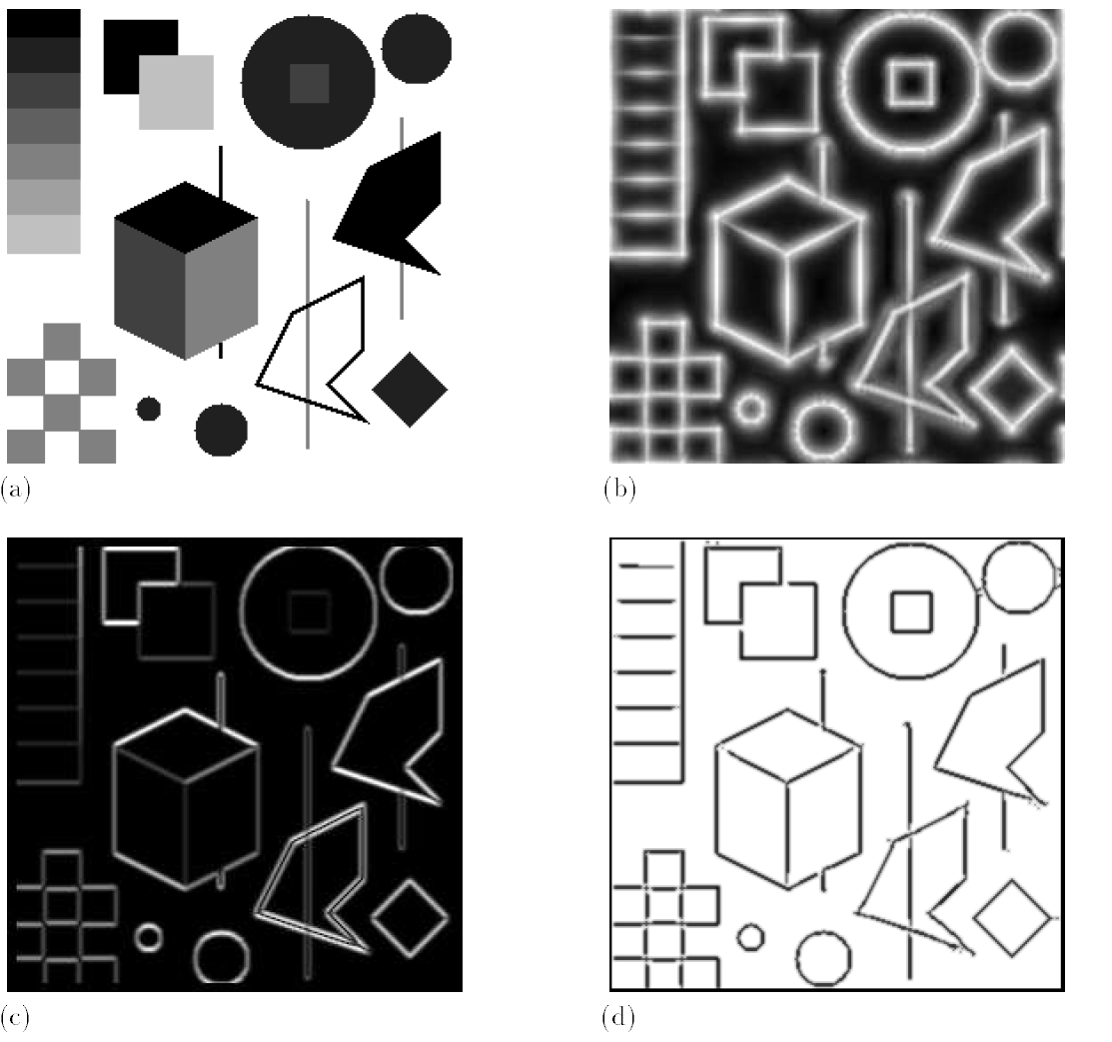
Experimental results
Raw image
Raw phase congruency image
Canny detector image
Phase congruency image after non-maximal suppression and thresholding

Slide 19
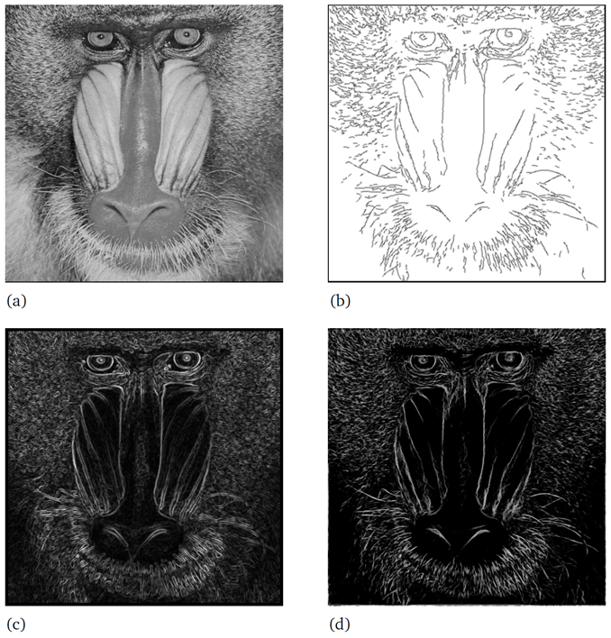
Experimental results
Raw image
Raw phase congruency image
Canny detector image
Phase congruency image after non-maximal suppression and thresholding

Slide 20
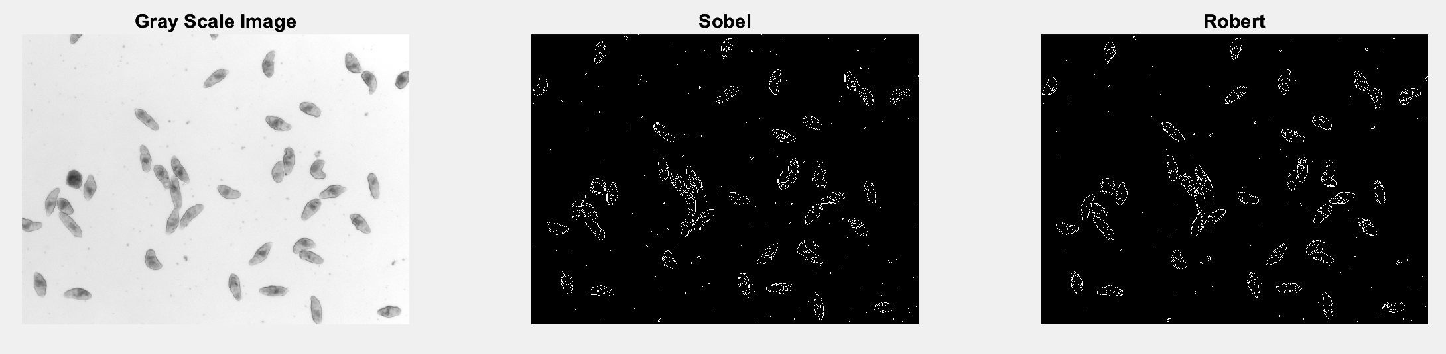
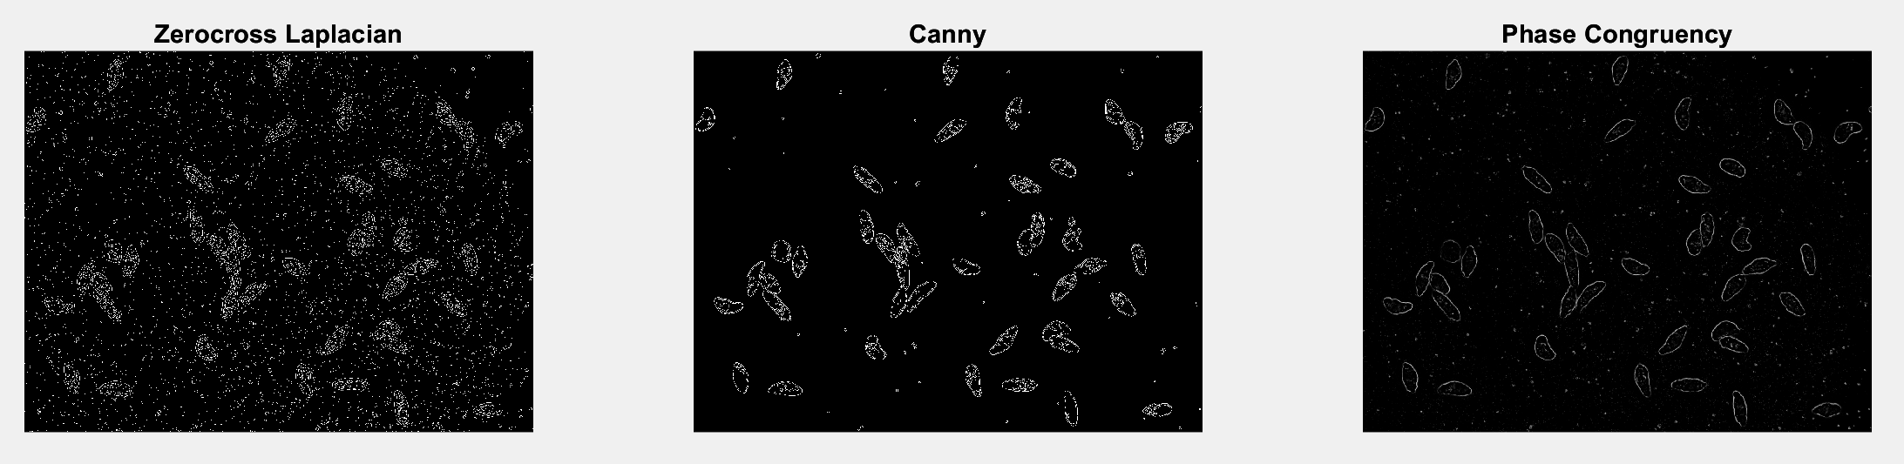
Experimental results: applied to parasites

Slide 21
conclusion
Phase congruency is another method to detect edges in images, like gradient and Laplacian methods
Phase congruency relies on the local energy principle, which is in agreement with cognitive processing models
Measuring the spread of frequencies is vital for localization
Thresholding and noise smoothing improve phase congruency results

Slide 22
References
[1] Kovesi, P. (1999). Image features from phase congruency. Videre: Journal of computer vision research, 1(3), 1-26.
[2] Kovesi, P. (1995). Image features from phase congruency. The University of Western Australia, Department of Computer Science 1-31.
[3] Asarnow, D.E., & Singh, R. (2013). Segmenting the Etiological Agent of Schistosomiasis for High-Content Screening. IEEE Transactions on Medical Imaging, 32, 1007-1018.
[4]. Wolfram Mathworld(2022, September 30). Fourier series. Retrieved 07:35, October 17, 2022, from https://mathworld.wolfram.com/FourierSeries.html

